Slide 1
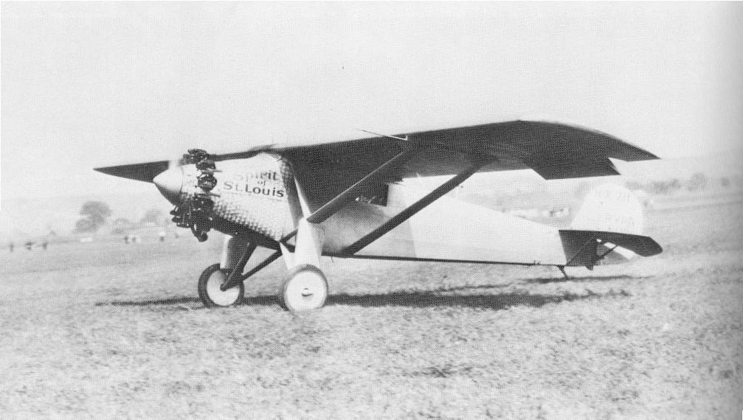
Ryan NYP “Spirit of St. Louis”
Notes:
What's missing on this airplane? the front window!
Non-stop, no refueling. Took out the window and replaced with a fuel tank.
Wright Bros - 1903 - 12 seconds
NY to Paris - 1927 - 33 hours. After your flight tomorrow, think about sitting in it for 33 hours.

Slide 2
Summary of the Ryan NYP
1st non-stop flight from New York to Paris – May 1927
Pilot – Charles Lindbergh
Prize $ = $25,000
Flight time 33 hours, 30 minutes
Notes:
Wright Bros – 1903.
In a bit over 20 years, went from 12 seconds to 33 hours!
Very similar to what you'll be flying in, about 20 minutes. Think about spending 33 hours in it!

Slide 3
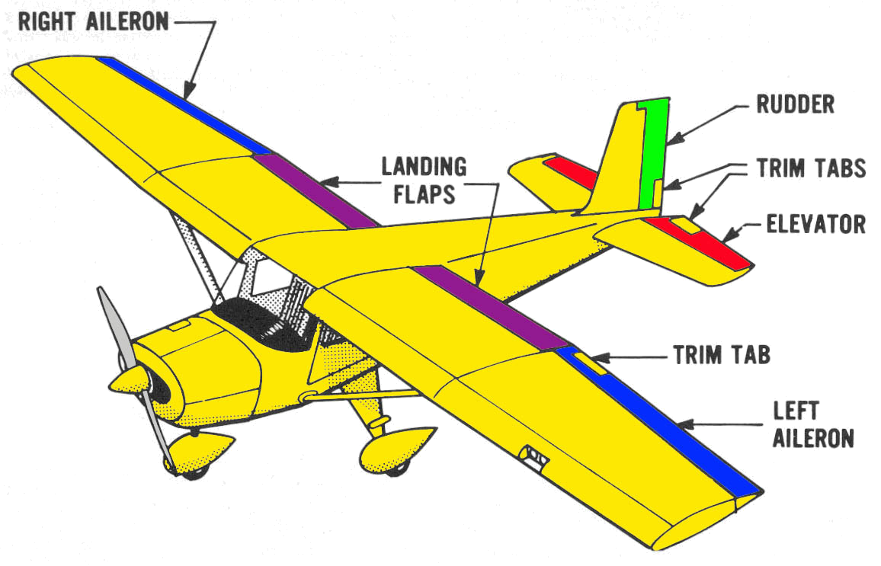
Parts of an Airplane

Slide 4
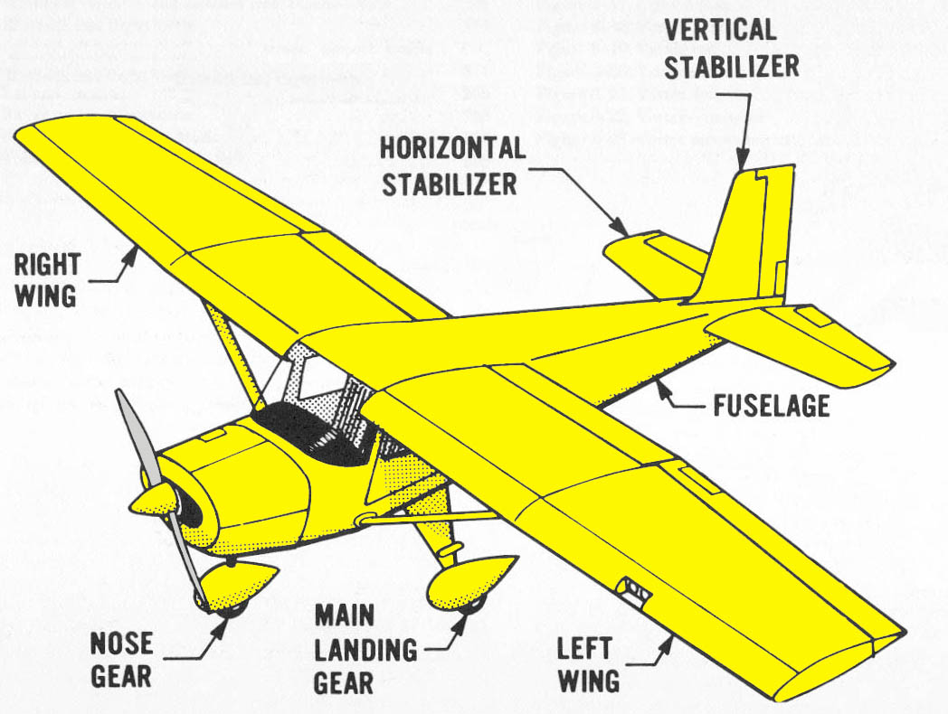
Airplane Basics – High Wing

Slide 5
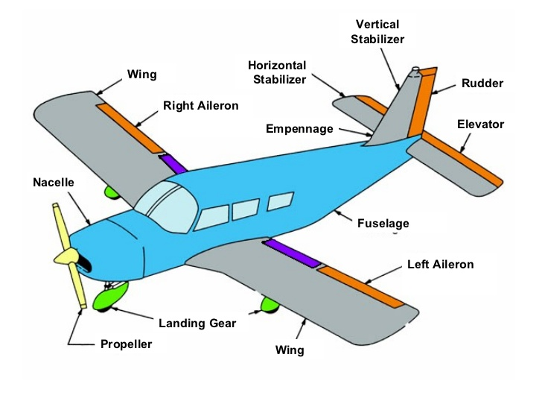
Airplane Basics – Low Wing

Slide 6
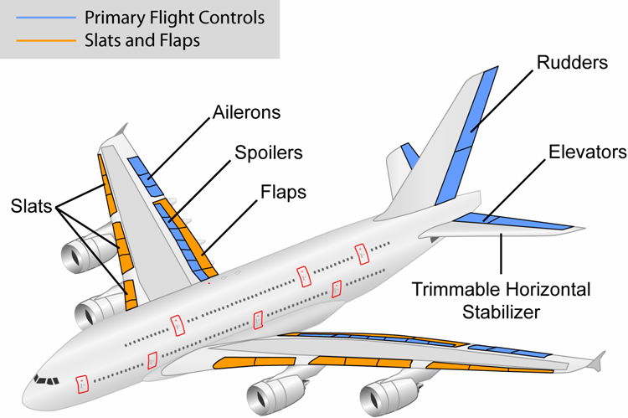

Slide 7
Aircraft Structures
Aircraft must have efficient structures
They MUST very light weight
Aircraft construction materials:
Wood, covered with fabric
Steel tube, covered with fabric
Aluminum
Composite, graphite or fiberglass
Notes:
Early airplanes of wood. What happens when wood gets or and/or wet? It gets weak.
WW2 - aluminum - very light and very strong.
Composite - 2 or more materials - All Airbus, Boeing 787, Cirrus
Woven fabric with glue - much like my shirt.
All sorts of things that used to be made of metal are now composites
The shape defines the strength, not the amount of materials.
Like drywall - the wood framing is rather flimsy but when you put the drywall up, the structure is very strong.

Slide 8
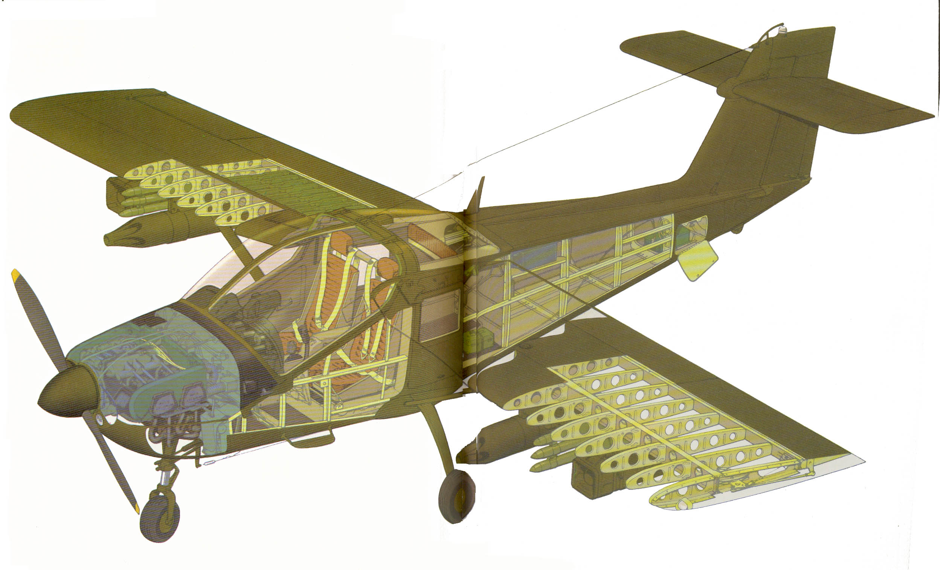
Cutaway View of an Aluminum Aircraft
Notes:
Ribs attach to the spar.

Slide 9
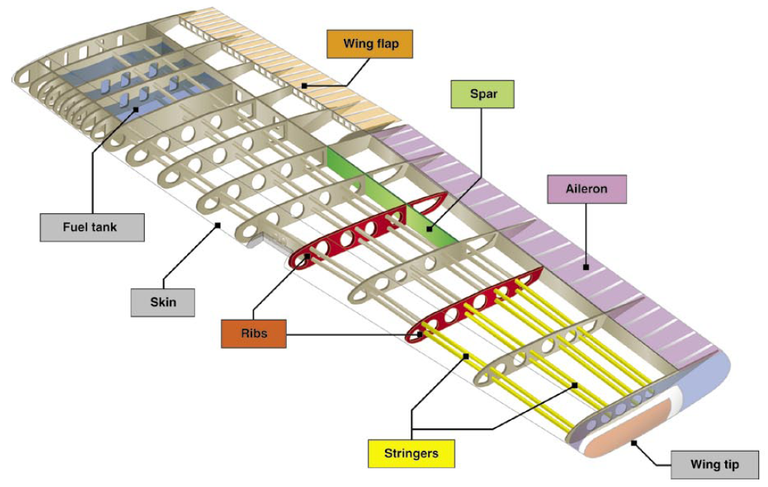
Cutaway View of an Aluminum Wing
Notes:
It's the structure, the shape, that provides the strength.
Holes in the ribs to reduce the weight.
Duct Tape airplane.
Pass around the rib – note the curved edges and rims – make it structurally stronger!

Slide 10
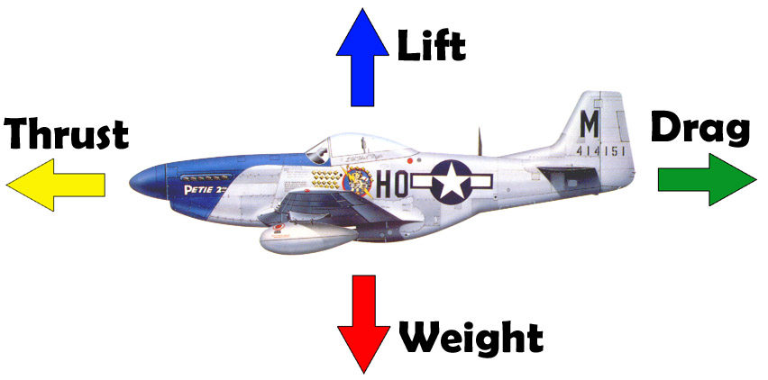
Forces Acting on an Aircraft
For Level Flight, Forces must balance

Slide 11
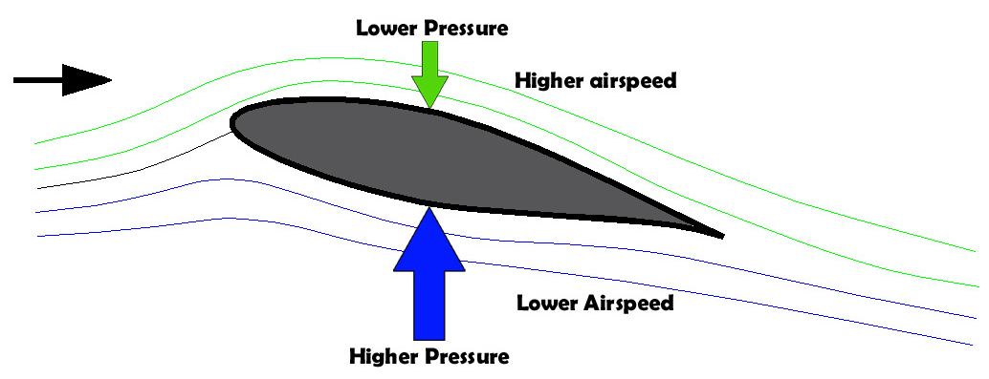
How Lift is Produced
2 related effects produce Lift: Bernoulli’s Principle & Downwash
Daniel Bernoulli discovered: As air speeds up it loses pressure
Air naturally speeds up over the top of a wing (1738)
The higher pressure below the wing lifts the plane
Downwash happens because of Newton’s 3rd law of motion
For every action there is an equal and opposite reaction
Notes:
Use model of the cross section of the wing. This is an airfoil.
Bernoulli - lived 100s of years ago, knew nothing of aviation but discovered air moves faster over a curved surface - like a wing (airfoil)
Because there's more distance on the top of a curved wing, the air must move faster than the air below the wing because the air wants to meet at the back edge of the wing.
As air speeds up, it loses pressure.
As a wing goes thru the air, it splits the airstream.
So the top of the wing is lower air pressure than the bottom.
If you're going to pursue something like aeronautical engineering, you'll probably spend a semester studying this.

Slide 12
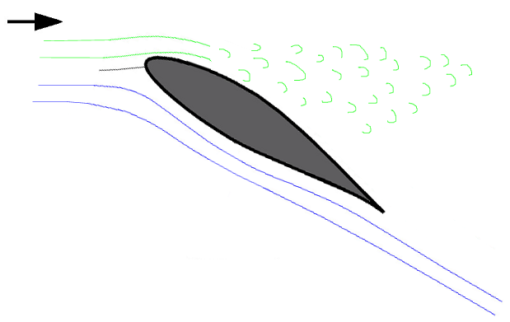
Wing “Stall”
If the wing angle gets too high, the air “separates” and the wing stops producing lift.
Notes:
Critical Angle of Attack.
Stall - engines don't stall. Airfoils (wings) stall when the air flowing over the wing is disrupted and the wing stops flying - no more lift!
Use airplane model to illustrate wing angle.
Once the wing stalls, it lowers and there's no more stall.
This is something you learn and demonstrate for your checkride.
No big deal at altitude.
But what about landing? Don't want to stall close to the ground because there's not enough altitude recover.

Slide 13
Aircraft Stability & Center of Gravity (CG)
The ability of an aircraft to fly straight and level
You can be "Out of CG" either too far forward or too far back
Heavy in front = difficult to takeoff or land
Heavy in back = difficult to recover from a spin
Notes:
Center of Gravity

Slide 14
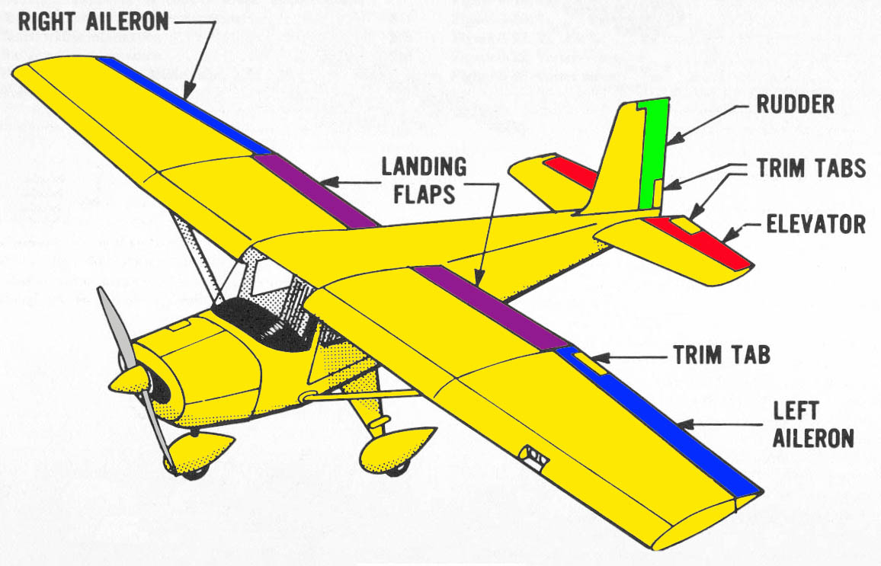
Aircraft Stability and Control Centrifugal Acceleration & Roll
Notes:
Roll, pitch and yaw.
How we turn an airplane. Just like a bicycle! Lean into the turn.
Coordinated turn.
2G Turn.
Fighter pilots & aerobatic pilots go thru 4-8G turns!

Slide 15
Controlling the aircraft
What allows the pilot to fly the airplane in directions other than straight and level?
Roll – roll around (ailerons)
Pitch – nose up & down (yoke or stick)
Yaw – swing left & right (rudder)
Notes:
Roll, pitch and yaw.
Have the kids do the 3-axis model with thumb, pointer finger and middle finger.
Thumb points up (roll)
Index finger points forward (pitch)
Middle finger points to the side (yaw)
Rotate by turning the hand around each of the fingers.

Slide 16
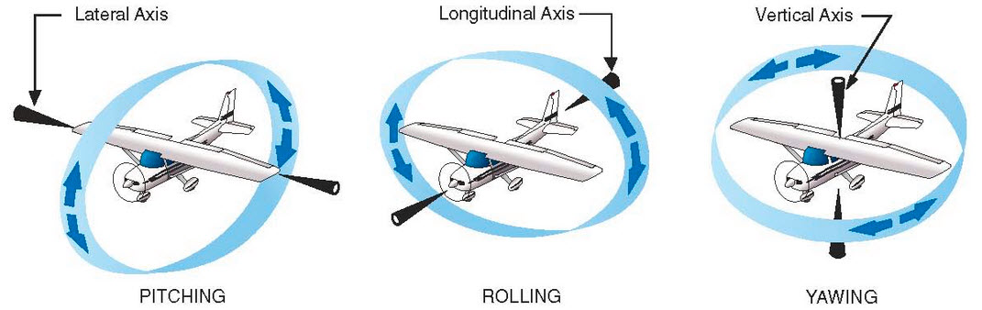
Pitch, Roll, and Yaw
Notes:
Pitch = Elevator; Roll = Ailerons; Yaw = Rudder

Slide 17
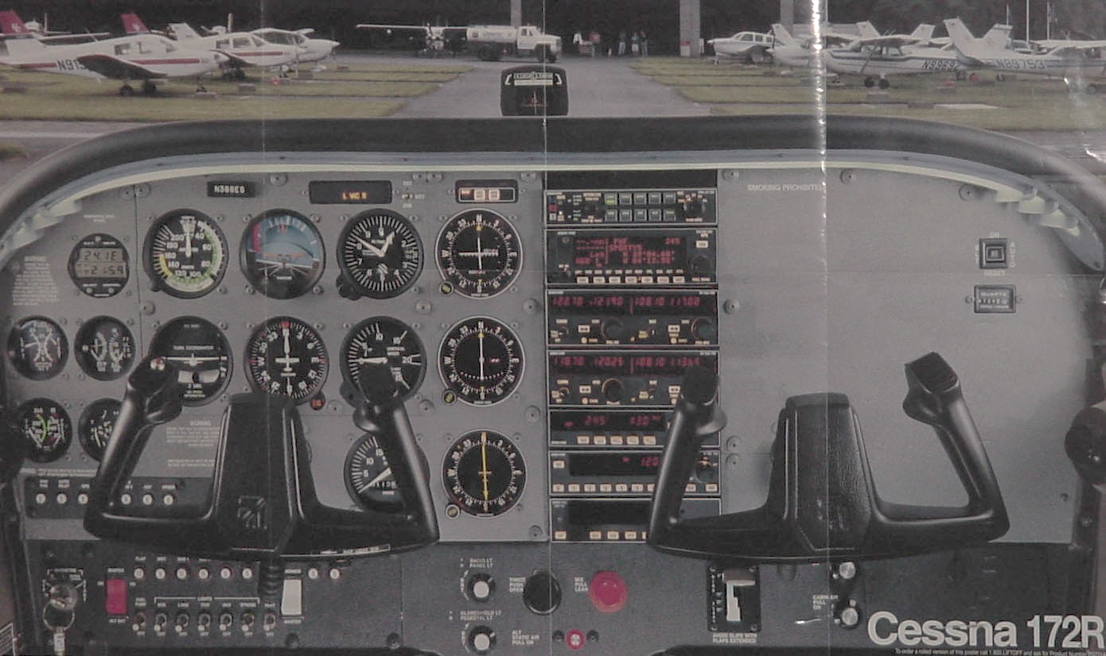
In the Cockpit

Slide 18
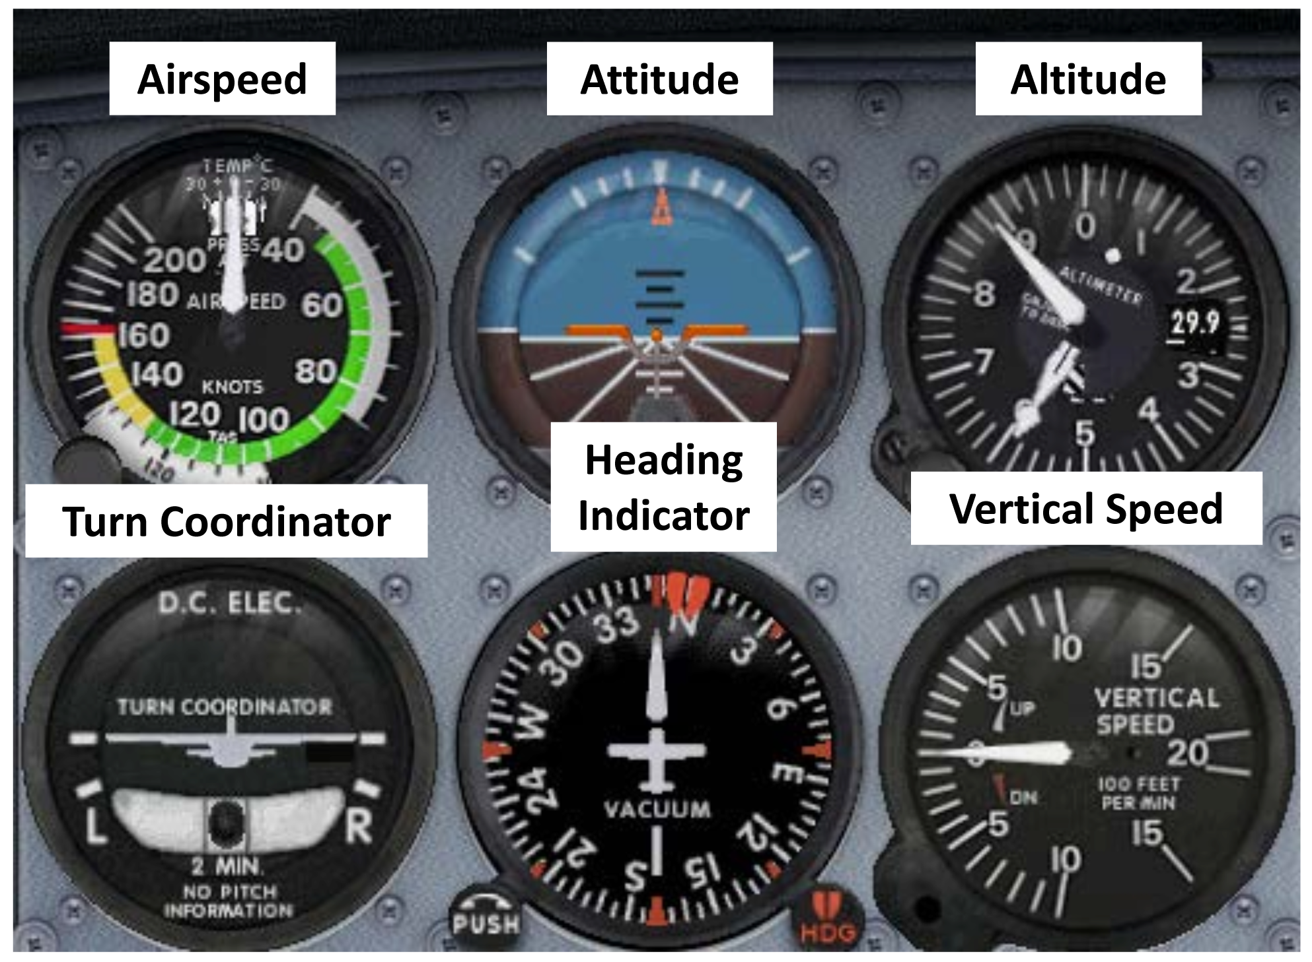
Primary Flight Instruments
The "Six Pack"
Notes:
Everything in aviation is Compass Heading.
Magnetic heading, not true!

Slide 19
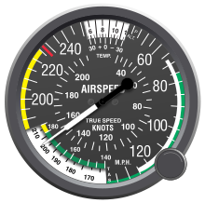
Airspeed Indicator
Use the throttle and pitch of the airplane to make the airplane go faster or slower
Throttle – gas pedal. More power, airplane climbs.
Pitch – tilt nose up or down to change speed.
Notes:
Depends on both Static Port AND Pitot Tube. Most aircraft have an alternate static switch.
“Knot” is a nautical mile per hour. Nautical miles are 15% greater than statute miles. (6008 ft. vs. 5280 ft.)
White arc is flap extension speed.
Green arc is normal operating speed.
Yellow arc is caution area - smooth air only.
Red line shows “never exceed” speed (Vne).

Slide 20
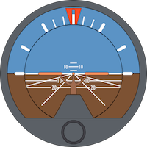
Attitude Indicator
Use the yoke or joystick to turn the airplane (the ailerons & rudder) and climb/descend (the elevator)
Shows Roll, Pitch and Yaw
Notes:
Artificial Horizon. Indicates pitch and roll.
Keep the blue over the brown.
Dot is the propeller, two horizontal bars are the wings.
Hash marks indicate bank angles.

Slide 21
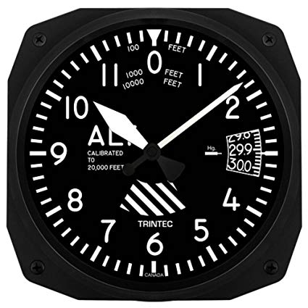
Altimeter
How high (altitude) are we above Sea Level (MSL) -- not the ground!
Big hand – on the 10, so we're at least 10,000 ft above sea level.
Long skinny hand – almost on the 2, so add 100 + 3 little hash marks or 10,130 ft MSL

Slide 22
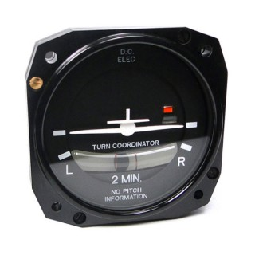
Turn Coordinator
Helps the pilot make a Quality turn
Controlled by the rudder (pedals) and the yoke or joystick
2 min turn – takes 2 minutes to do a complete 360 deg turn.
Notes:
Really two instruments
Miniature aircraft shows turn rate only - does not show bank angle
Inclinometer shows quality of turn - Coordinated, slip, skid
A standard rate turn is 3 degrees per second. At 100 mph, approximately 15 degrees of bank will produce a standard rate turn.
If aircraft is not in coordinated flight, the ball will not be centered. The correction is to “step on the ball.”
A skid is to much rudder for the aileron input, and will be indicated by the ball displaced to the outside of the turn.
Conversely, a slip is not enough rudder for the aileron input, and will be indicated by the ball displaced to the inside of the turn.

Slide 23
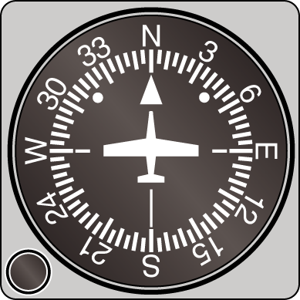
Heading Indicator
What direction are we going?
Controlled by the yoke or joystick to change the ailerons to turn (roll) the airplane

Slide 24
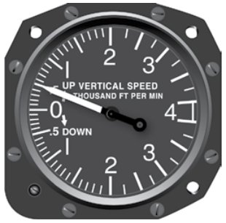
Vertical Speed Indicator
How fast are we climbing or diving?
The hand it pointing between 0 and 1, so we're climbing at 500 ft per minute

Slide 25
Digital or Glass Panel
Same instruments as the Six-pack
But a different format
Airspeed and Altitude are vertical "tapes"
And More!
Time
Outside temperatre
Ground speed
Health of the engine (oil, temp, battery)

Slide 26
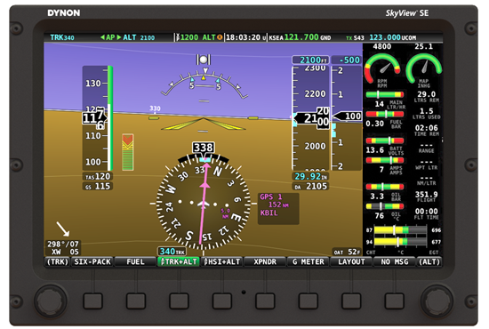
Dynon
Notes:
Most of your time should be looking out the window, not at the screens.

Slide 27
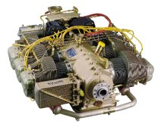
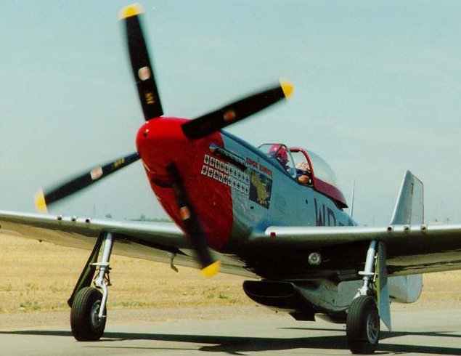
Propulsion – Piston Engines
Most aircraft engines have 4 or 6 cylinders, like cars
Most aircraft engines are air-cooled
A propeller converts the engine power into thrust
Notes:
Prop attaches to the crankshaft, the cylinders move the crankshaft
The prop is also an airfoil - turns power into thrust.
Why are engines air cooled? - weight - water is 8 pound per gallon.
Air is forced around the cylinders moving at hurricane speeds (90-200+ mph)
Gliders - Miracle on the Hudson - a 737 became a glider and landed. It was under complete control and did not crash, did no hurt anyone (much).

Slide 28
Do airplanes crash when the engine stops running?
Notes:
Get variety of answers from the kids.

Slide 29
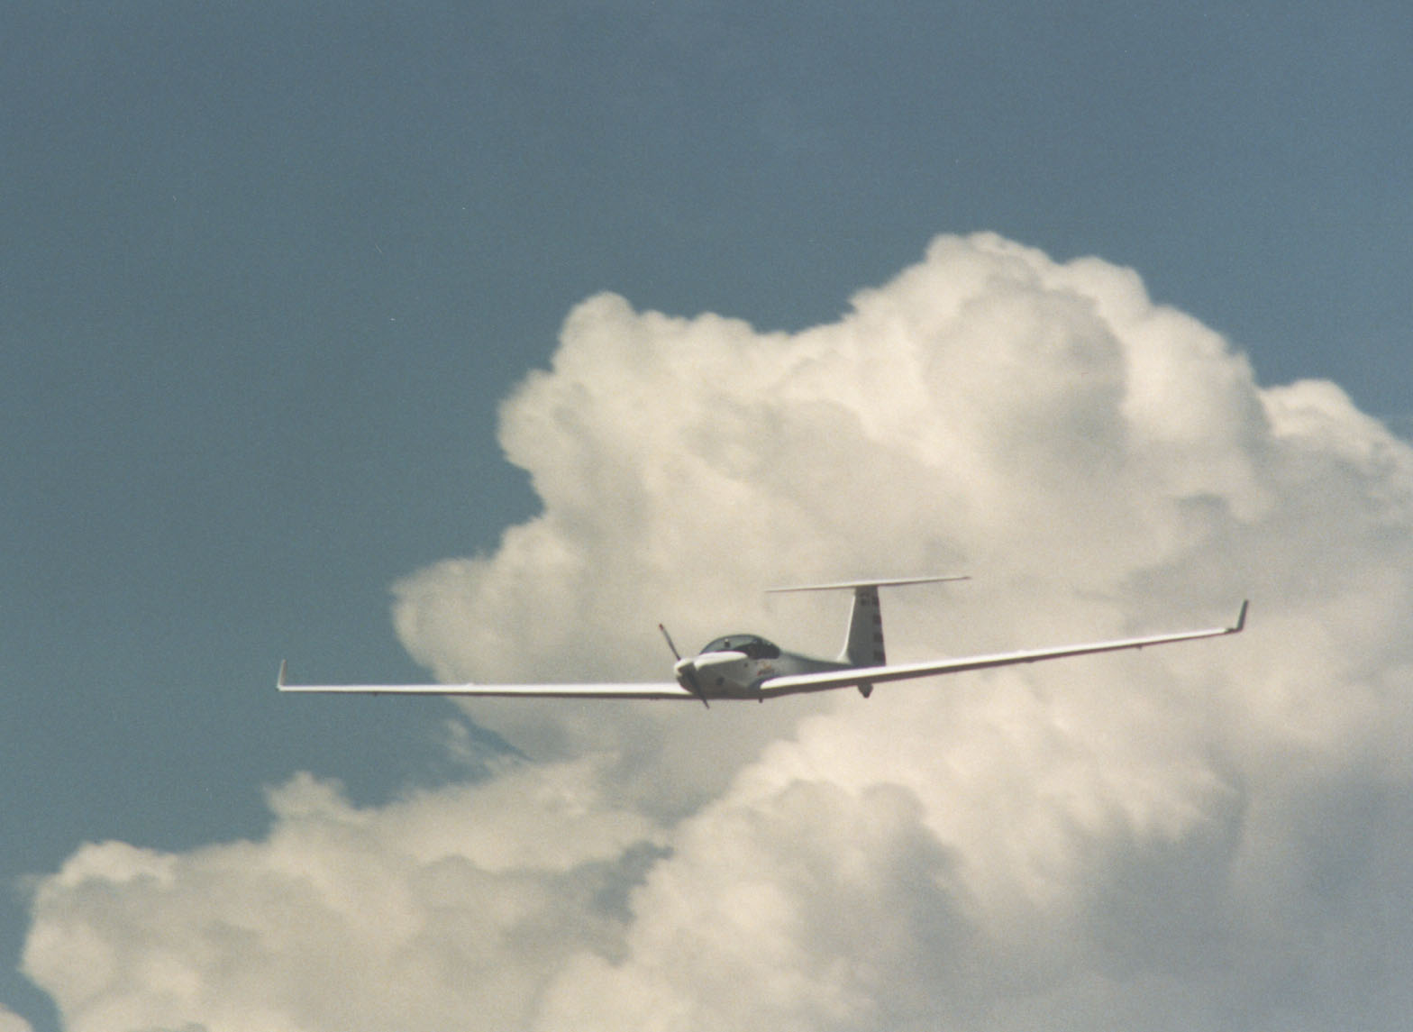
Nope.
Airplanes essentially become gliders when the engine stops running.
They still fly very well, the pilot just needs to look for an airport to land at.
Real soon.

